Slide 1

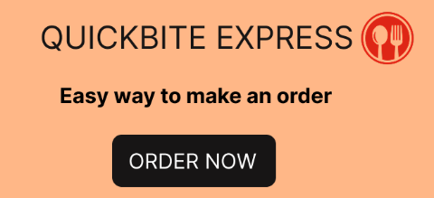
Insights for Crisis Recovery in an Online Food Delivery Startup
Codebasics Resume Challenge
Presented By
K. Poojitha
Notes:
Hi I’m Poojitha and Today
I’ll be diving into a deep strategic analysis of QuickBite Express — a fast-growing Bengaluru-based food-tech startup — and how it navigated one of the biggest crises in its journey.
QuickBite Express, founded in 2020, connects customers to nearby restaurants and cloud kitchens through a fast and seamless delivery experience. But in June 2025, the company faced a major setback.
In this session, I’ll walk you through key findings, customer behavior insights, delivery performance trends, and strategic recommendations that can help the platform build a high-retention, high-efficiency food delivery ecosystem.
This analysis is part of the Codebasics Resume Project Challenge, where we use real-world datasets to extract insights and solve meaningful business problems through data storytelling.

Slide 2
Problem Statement:
QuickBite Express faced a major crisis in June 2025 due to:
Viral social media reports on food safety violations
A week-long delivery outage during monsoon
This led to a sharp drop in orders, customer churn, negative sentiment, partner restaurant exits, and rising acquisition costs. QuickBite now needs data-driven insights to recover trust and stabilize operations.
Business Objectives :
Measure crisis impact on orders, revenue, delivery performance, and rating, Identify churned & high-risk customer segments.
Analyse operational gaps (SLA, cancellations, delays)
Understand sentiment trends and key complaint drivers
Support recovery strategy through targeted campaigns, partner retention, and improved service quality
Notes:
QuickBite Express, founded in 2020, connects customers to nearby restaurants and cloud kitchens through a fast and seamless delivery experience. But in June 2025, the company faced a major setback.
A viral social media incident exposing food safety violations at partner restaurants, combined with a week-long delivery outage during the monsoon season, triggered massive customer backlash. Competitors quickly took advantage with aggressive marketing campaigns, accelerating customer churn and weakening brand trust.

Slide 3
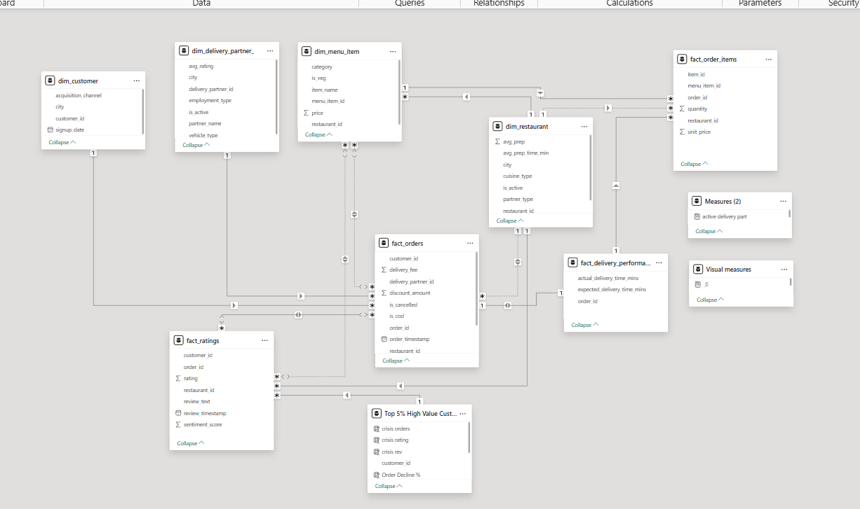
Data Model:
Notes:
For this study, I used a clean star-schema data model along with multiple datasets covering orders, customers, delivery partners, ratings, and restaurant performance.
These insights help uncover key patterns in customer behaviour, operational efficiency, delivery performance, and partner contribution.

Slide 4
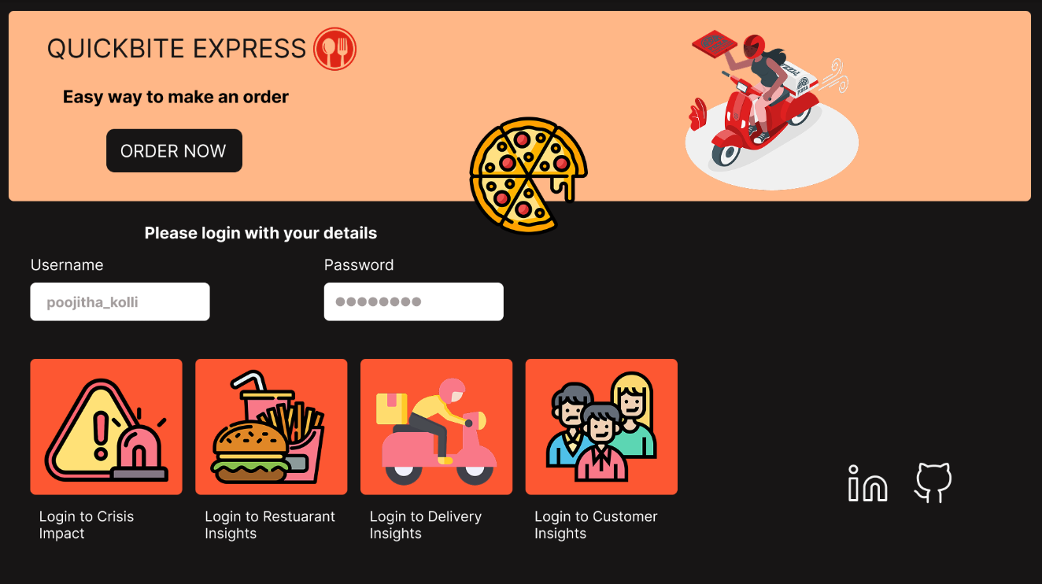
DASHBOARD
Notes:
To bring these insights to life, I developed an interactive dashboard that visualizes all the key performance metrics of a food-delivery business.
The dashboard highlights trends in monthly orders, customer retention, delivery partner performance, restaurant contribution, ratings, and overall operational efficiency.
Feel free to explore it and share any suggestions for improvement!

Slide 5
Primary Questions
Notes:
Let’s begin by outlining the key research questions that shaped our analysis.

Slide 6
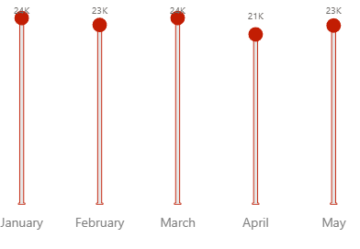
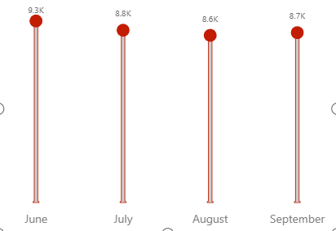
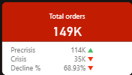
1. Monthly Orders: Compare total orders across pre-crisis (Jan–May 2025) vs crisis (Jun–Sep 2025). How severe is the decline?
pre-crisis
crisis
Notes:
Before the crisis hit, QuickBite was performing strongly.
-- Between January and May 2025, the platform recorded a solid 114K orders, with monthly volumes staying healthy—24K in January, 21K in February, and consistently high through May.
But once the crisis began in June, everything changed.
From June to September 2025, total orders dropped to just 35K—a massive 69% decline compared to the pre-crisis period.
-- To put it in perspective:
June saw only ~9K orders,
and by September, the number fell to just 8K, one of the lowest monthly volumes of the year.
This steep drop reveals how sharply customer trust and platform usage collapsed during the crisis, marking one of the most challenging phases in QuickBite’s growth journey.

Slide 7
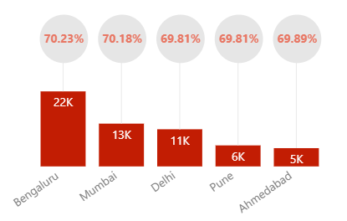
2. Which top 5 city groups experienced the highest percentage decline in orders during the crisis period compared to the pre-crisis period?
Notes:
Among all city groups, two major metros were hit hardest:
Bengaluru — Highest Drop in Order Volume
Bengaluru saw a sharp decline of 22K orders, dropping by 70.23% when comparing pre-crisis to crisis volumes.
This makes it the most affected city, signalling how strongly the crisis disrupted customer confidence in QuickBite’s largest market.
2. Mumbai — Second-Highest Decline
Mumbai recorded a 13K reduction in orders, with a 70.18% decline overall.
Even though Mumbai wasn’t hit as severely as Bengaluru, the drop still represents a major shift in customer behaviour during the crisis period.

Slide 8
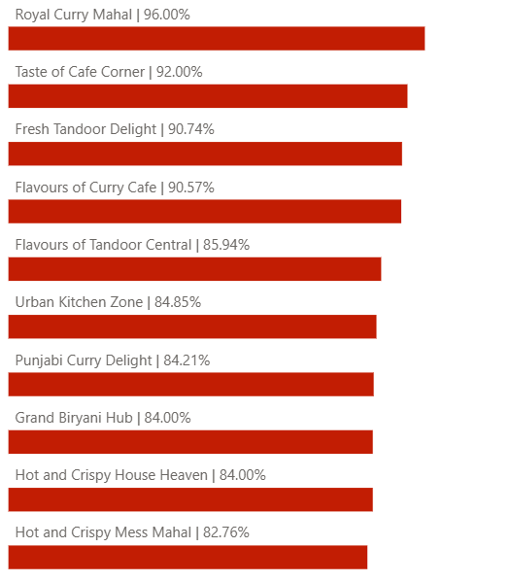
3. Among restaurants with at least 50 pre-crisis orders, which top 10 high-volume restaurants experienced the largest percentage decline in order counts during the crisis period?
Notes:
Among restaurants that had at least 50 pre-crisis orders, the crisis had a severe impact on several previously high-performing outlets.
The top restaurants with the largest percentage drop in order volume during the crisis were:
1. Royal Curry Mahal — 96% Decline
This restaurant took the biggest hit, with order volumes almost collapsing.
A 96% drop indicates complete customer disengagement, likely influenced by food safety concerns or severe delivery delays.
2. Taste of Cafe Corner — 92% Decline
This outlet also saw orders fall drastically.
A decline above 90% shows that even loyal repeat customers avoided the brand during the crisis.
3. Fresh Tandoor Delight — 90.74% Decline
Despite being a high-volume performer before the crisis, this restaurant experienced a major downturn.
Such a sharp fall signals strong sensitivity to brand reputation and operational disruptions.
4. Flavours of Curry Cafe — 90.57% Decline
Another top-volume restaurant where demand dropped sharply.
The consistent pattern across these restaurants suggests that high-traffic outlets were disproportionately impacted during the crisis.

Slide 9
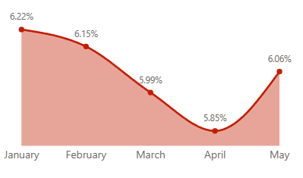
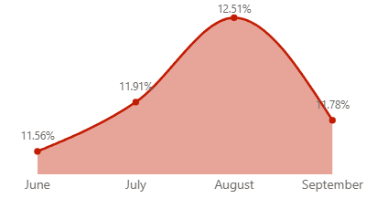
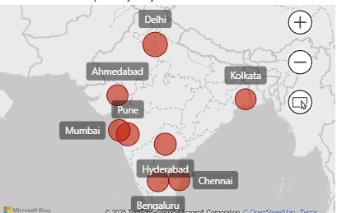
4. Cancellation Analysis: What is the cancellation rate trend pre-crisis vs crisis, and which cities are most affected?
pre-crisis
crisis
Notes:
Order cancellations doubled during the crisis, rising from 6% pre-crisis to 12% during the crisis, reflecting declining customer trust and service disruptions.
The cities most affected were:
Delhi — 48.80% (highest spike)
Pune — 42.66%
Mumbai — 37.24%
Other cities also showed a clear increase in cancellation rates.
Overall, the trend shows that cancellations escalated sharply across regions as the crisis unfolded.

Slide 10
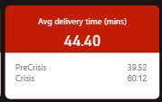
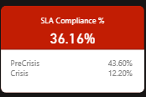
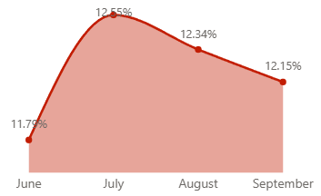
5. Delivery SLA: Measure average delivery time across phases. Did SLA compliance worsen significantly in the crisis period?
Crisis Period SLA %
Notes:
Delivery efficiency dropped sharply during the crisis period.
Average Delivery Time:
Pre-crisis: 39 mins
Crisis: 60 mins
SLA Compliance:
Pre-crisis: 43%
Crisis: 12%
These metrics clearly show that SLA compliance worsened drastically, with longer delivery times and a steep drop in successful on-time deliveries.

Slide 11
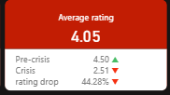
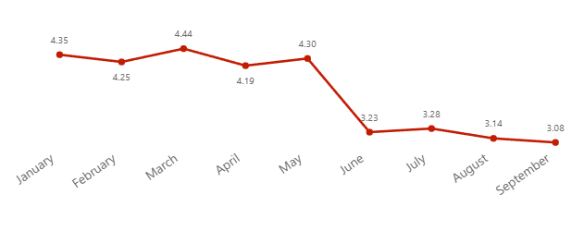
6. Ratings Fluctuation: Track average customer rating month-by-month. Which months saw the sharpest drop?
Monthly avg rating
Notes:
Customer ratings remained strong during the pre-crisis months, averaging 4.3 to 4.5 from January to May.
However, once the crisis hit in June, ratings dropped sharply:
June: 3.23
This marks the steepest month-to-month decline, clearly reflecting customer frustration due to food safety concerns and delivery outages.

Slide 12
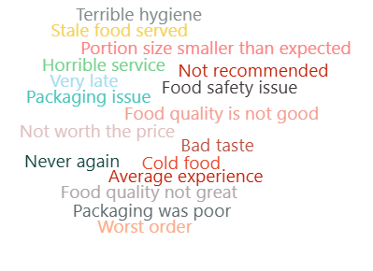
7. Sentiment Insights: During the crisis period, identify the most frequently occurring negative keywords in customer review texts. (Hint: Use a Word Cloud visual in Power BI to visualize the findings.)
Notes:
A word-cloud analysis of customer reviews during the crisis period revealed several recurring negative keywords. These highlight the main pain points driving dissatisfaction:
“Terrible hygiene”
“Stale food”
“Horrible service”
These keywords indicate that customer frustration was driven by food safety issues, quality concerns, and service failures, directly aligning with the crisis events QuickBite faced.

Slide 13
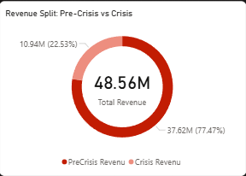

8. Revenue Impact: Estimate revenue loss from pre-crisis vs crisis (based on subtotal, discount, and delivery fee).
Notes:
QuickBite’s revenue dropped sharply once the crisis began.
Pre-crisis Revenue: ₹37.62M
Crisis Revenue: ₹10.94M
This represents a 70% revenue loss, driven by falling order volumes, higher cancellations, and reduced customer spending during the crisis period.

Slide 14
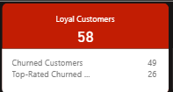
9. Loyalty Impact: Among customers who placed five or more orders before the crisis, determine how many stopped ordering during the crisis, and out of those, how many had an average rating above 4.5?
Notes:
Among customers who placed 5 or more orders before the crisis, a significant portion stopped ordering once the crisis began:
Total Loyal Customers: 58
Churned During Crisis: 49
Top-Rated Churned Customers (Avg Rating > 4.5): 26
This shows that even highly satisfied and loyal customers were heavily impacted, signalling a major trust breakdown during the crisis.

Slide 15
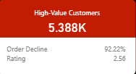
10. Customer Lifetime Decline: Which high-value customers (top 5% by total spend before the crisis) showed the largest drop in order frequency and ratings during the crisis? What common patterns (e.g., location, cuisine preference, delivery delays) do they share?
Notes:
Among the top 5% high-value customers (5.388K), there was a severe drop in engagement:
Order Frequency Decline: 92.22%
Crisis Rating: 2.32
Common Patterns Noticed
High-value customers mostly showed:
Concentration in Tier-1 cities(Bengaluru, Mumbai, Hyderabad)
Exposure to long delivery delays
Complaints about hygiene, stale food, and poor service
Dependence on high-volume restaurants that also saw major decline

Slide 16
THANK YOU
Notes:
Thank You

